Slide 1
MALWA INSTITUTE OF TECHNOLOGY INDORE
Minor Group Project Presentation
Auto Rescue: Automated Ambulance Dispatch System
Presented By Group 6 Members
Lokesh Vishwakarma
Bhupendra Vishwakarma
Deepak Rathor
Branch : IT
Year : 3rd

Slide 2

TITLE
Auto Rescue: Automated Ambulance Dispatch System

Slide 3
CONTENT
Objective
Problem
Innovation
Solution
Advantages
Design

Slide 4

OBJECTIVE :
Creating a system that automatically calls the ambulance of the nearest hospital to the accident point is a valuable endeavor with several important objectives:
Minimized Human Error
Real-Time Communication
Emergency Medical Guidance
Community Health and Safety
Reduced Language Barriers
Life-Saving

Slide 5

PROBLEM :
Problem : The current state of emergency response remains burdened by inefficiencies and delays. In the absence of this transformative solution, accidents continue to be met with inconsistent and often inadequate response times, exacerbating the potential for severe injuries or fatalities.

Slide 6
Report Of People Died Due To Delay Of Calling Ambulance :
Accident Deaths in Thousand

Slide 7

Innovation :
Innovation :The innovation behind Auto Rescue lies in its revolutionary approach to emergency response. By seamlessly integrating cutting-edge sensors, real-time data analysis, and advanced artificial intelligence algorithms,

Slide 8
SOLUTION
BAND
CAR
Faster Assessment
Data-Driven Safety Improvements
Accurate Accident Reporting
Public Safety Awareness
Improved Hospital Preparedness
Minimized Treatment Delays
Reduced Response Time
Reduced Response Time
Swift Emergency Response
Life-Saving Potential
Unconscious or Inaccessible Victims
Accuracy of Location
Peace of Mind
Community Wellbeing

Slide 9
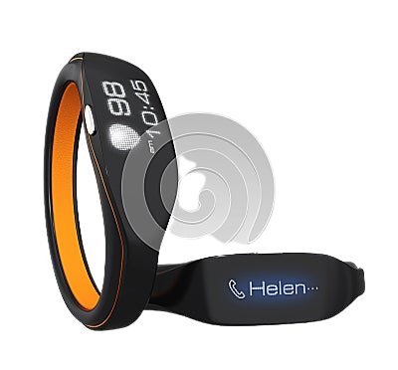
BAND DESIGN :
Features
Accident Detection
Sensors Data Transmission
Automatic Emergency Alert
GPS and Location Tracking
Fall Detection
Durability and Waterproofing

Slide 10

CAR DESIGN :
Features
Impact Sensors
Data Processing Unit
Damage Classification
Camera Integration
Damage Localization
Communication Module

Slide 11
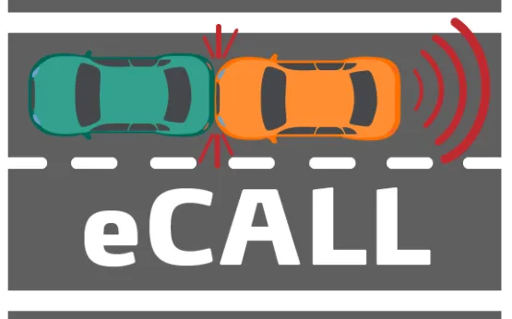
E-Call System :
An "eCall" system, short for "Emergency Call," is a telematics technology designed for vehicles to automatically call emergency services in the event of a serious accident. It's a safety feature that aims to provide rapid assistance to drivers and passengers when they're involved in a collision or accident. When triggered, the eCall system establishes a connection with emergency response centers, transmitting crucial information about the accident, such as the vehicle's location and impact severity. This technology can greatly reduce response times, potentially saving lives by ensuring that help arrives as quickly as possible.

Slide 12
The Key Features Of An E-call System :
Automatic Activation: The system is designed to activate automatically when sensors detect a significant impact, such as during a crash.
Emergency Services Connection: The eCall system establishes a direct communication link with emergency services, transmitting relevant data in real-time.
Location Information: The system provides accurate GPS coordinates to emergency responders, enabling them to locate the accident scene swiftly.
Voice Communication: In addition to transmitting data, the system may also enable two-way voice communication between vehicle occupants and emergency operators.
Data Transmission: The system sends essential information about the vehicle's make, model, and potentially the number of occupants to assist responders.
Speed and Impact Data: Some eCall systems may transmit information about the vehicle's speed and the force of impact, aiding in assessing the severity of the accident.

Slide 13


